Slide 1

The Role of Artificial Intelligence in Expert Investigations and the Preparation of reports
Thomas Wood
Director, Fast Data Science
Expert Witness CUBS certificate

Slide 2
Overview of large language models
In this talk we will discuss the use of large language models (LLMs), or generative AI, for expert witness reports.
There are other uses of AI, such as regression models, but these tools need an advanced level of programming skill to use. I will focus on the AI tools which have recently become widely available, which are LLMs such as ChatGPT or Gemini.
Large language models are essentially a predictive text model, run over and over again to generate more and more words.
Remember the old Nokia phones with predictive text? An LLM is like this but with a longer context window.

Slide 3
Expert witness responsibility
England and Wales: expert witness reports are governed by CPR Part 35 and Practice Direction 35.
An expert witness is a witness of opinion, as opposed to a witness of fact.
Statement of truth:
I confirm that I have made clear which facts and matters referred to in this report are within my own knowledge and which are not. Those that are within my own knowledge I confirm to be true. The opinions I have matters to which they refer.
Ireland: Order 39 Rules of the Superior Courts cover duty to the court and avoiding bias.
In practice, expert witnesses can and do delegate parts of the report writing or investigation to subordinates, but the expert has ultimate responsibility for the content of the report. I would imagine the same rule to apply to any use of generative AI.

Slide 4
Hallucinations
LLMs are prone to hallucinations.
There is also “semantic leakage”.
“Her favourite colour is yellow. She presented at the emergency room complaining of a high temperature, headache, being sick, and aches and pains” -> GPT 4o gives diagnosis of “jaundice” because of the mention of “yellow”.
A large amount of the training data in LLMs is US specific, so you get content which is noticeably the wrong jurisdiction.

Slide 5
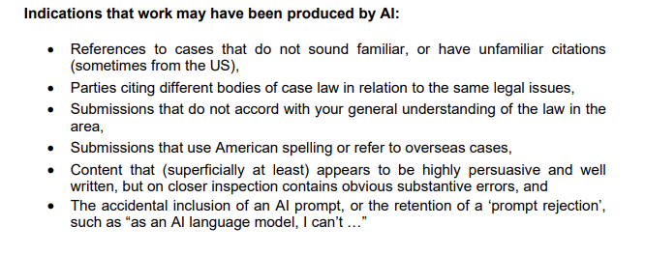
Hallucinations
UK Courts and Tribunals Judiciary, Artificial Intelligence (AI) Guidance for Judicial Office Holders, Oct 2025

Slide 6
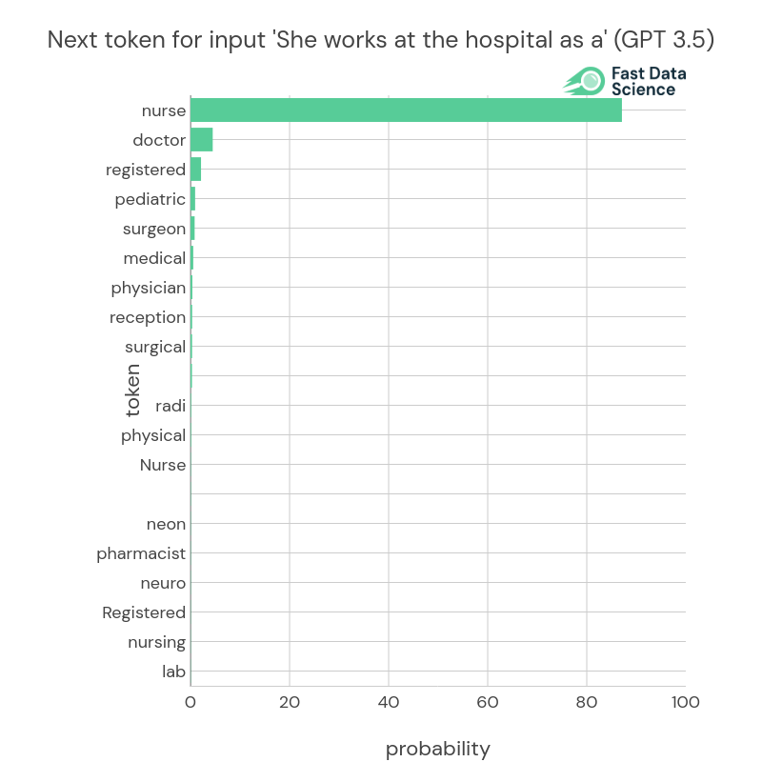
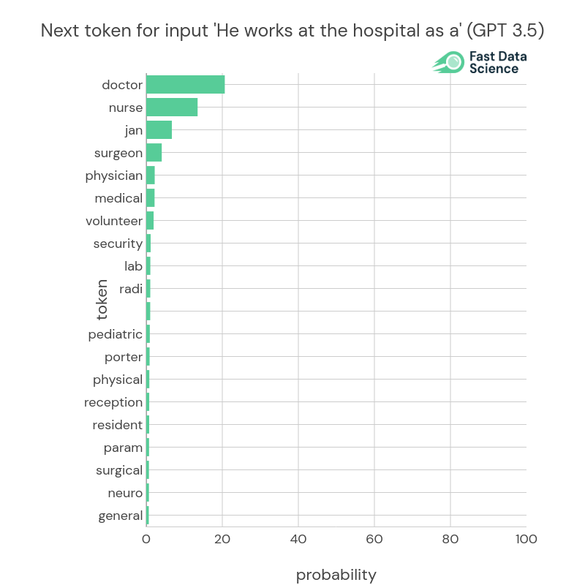
Bias
If an expert witness is a witness of opinion, how can we reconcile this with possible biases in an LLM’s output? This is a very visible example, but what about the unknown cases of bias?

Slide 7


When “AI slop” makes it to court…
There have been a number of cases in the UK, Ireland and the USA, where lawyers, expert witnesses, or litigants in person have used generative AI to prepare submissions to the court.
England: R (Ayinde) v Haringey: Court reduced costs due to wasted time from fake citations.
Ireland: Reddan v An Bord Pleanála HC 2025
England: Justice Waksman, Construction and Technology Court: a solicitor who insisted on an AI-generated expert report breached their duty.
“...Moreover, in R (on the application of Ibrahim) v Waltham Forest LBC [2019] EWHC 1873 (Admin), the court quashed a local authority decision due to…”
“Write a legal argument supporting XXX”
ChatGPT

Slide 8
When an expert uses AI without checking…
In New York state, an expert in fiduciary services used Microsoft’s Copilot to cross-check calculations he used in expert evidence. He was unable to recall the prompts he used, state the sources Copilot relied on, or explain how the tool worked and arrived at its outputs.
Matter of Weber 2024 NY Slip Op 24258, [Surrogate's Court, Saratoga County]
Quote from the ruling: This brings to mind the old adage, "garbage in, garbage out". Clearly a user of Copilot and other artificial intelligence software must be trained or have knowledge of the appropriate inputs to ensure the most accurate results.
Kohls v. Ellison (Minnesota): expert submitted report to the court containing hallucinations (nonexistent citations). Plaintiffs didn’t let him re-draft it because the hallucinations “cast doubt about the entire report”.
These cases cause reputational damage to implicated parties and may result in inadmissible evidence.

Slide 9
Privacy concerns
An LLM like ChatGPT is a third party service. It may also be hosted on a server in North America. So if you send confidential information in a prompt to ChatGPT in your browser,
you have no guarantee that OpenAI isn’t storing the data
you don’t know if you’re complying with GDPR
your data could be used for model training
in the USA: using GPT is not HIPAA compliant unless you follow certain steps
you should be aware if you are sending data across jurisdictions
Fortunately, many commercial versions of these platforms do offer confidentiality. The ChatGPT API needs programming skills to use, but does guarantee that data will not be retained.
In the UK, judges have been encouraged to use ChatGPT 365. A paid subscription like this usually guarantees that data will not be retained, but you should always check if the way you are using it complies with GDPR, HIPAA or other applicable rules.
If you would not post it on the internet, be careful about sending it to a chatbot.

Slide 10
Transparency, disclosure, IP
An expert witness report should declare the use of AI and the author should record all prompts used, as well as the version of LLM that was used to generate the outputs.
Be aware that an LLM takes into account the context of previous prompts, unless you have started a new conversation.
Intellectual Property Infringement and brand association: content generated by LLMs may violate intellectual property rights. See Getty Images v Stability AI (2025) - Getty alleged that Stability’s generated images violated their trademark rights.

Slide 11
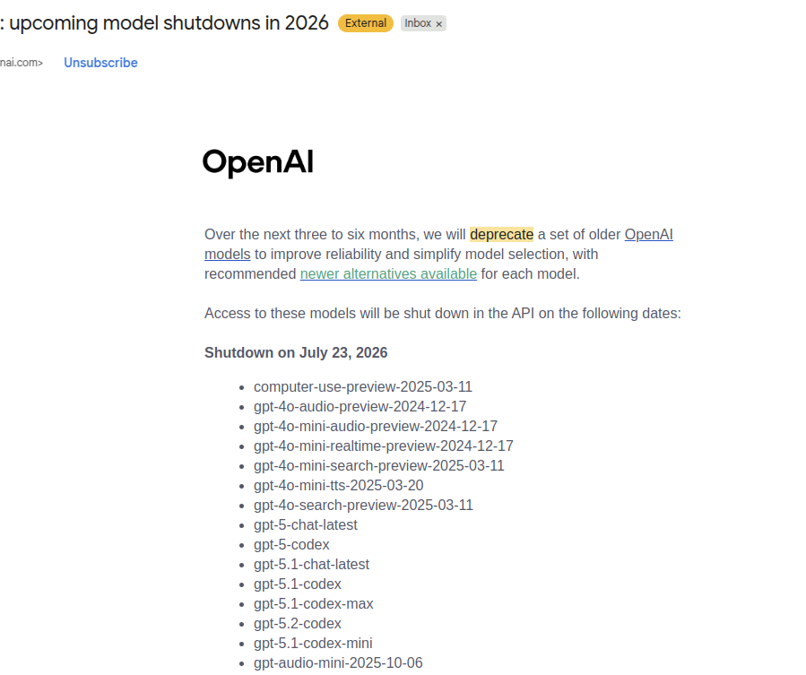
Black box syndrome and reproducibility
The UK Bar Council’s guidance also highlights the “Black Box syndrome”: the lack of explainability.
OpenAI’s models are closed source and closed weights (we don’t really know how they work!), and are regularly deprecated.

Slide 12
May 2026
Proposed updates to expert witness guidance regarding AI
UK Civil Justice Council: Use of AI for Preparing Court Documents: Interim Report and Consultation
https://www.judiciary.uk/wp-content/uploads/2026/03/Interim-Report-and-Consultation-Use-of-AI-for-Preparing-Court-Docume.pdf
Proposes a modification to PD 35.
We propose a requirement that the expert explains what use of AI has been made other than for transcription (or other administrative uses) and that the expert identifies the AI tools used.
United States: Proposed Rule 707 for the Federal Rules of Evidence: AI evidence must be subject to the same standards as expert evidence.

Slide 13

Low vs high risk uses of AI
A lot of the new official and unofficial guidance (UK, US, EU) makes the distinction between low and high risk use cases of AI.
Where do we think these tasks belong on a scale from low to high risk?
Machine translation
Expert builds and uses their own AI model
Expert models scenarios with GPT
Spell check
Online research
Data analysis
AI writes a section of the report

Slide 14
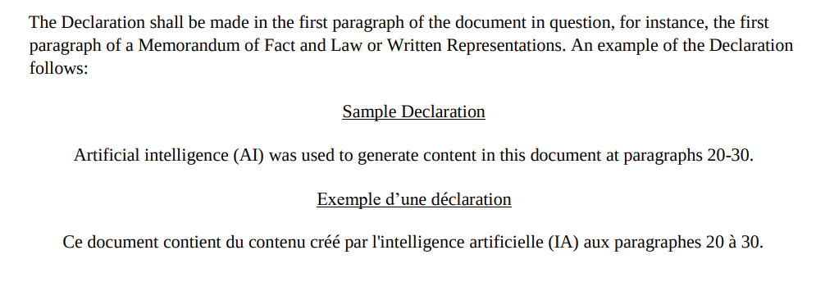
Judicial Guidance on AI (Oct 2025)
Takeaways from Judicial Guidance which are relevant for expert witnesses:
Understand the capabilities and limitations of the AI tool you are using
Uphold confidentiality and privacy
You can use AI for administrative tasks such as document summarising, but not for analysis that requires professional judgement.
You need to check output for hallucinations and bias
The expert is still accountable for the work produced in their name.
https://www.judiciary.uk/wp-content/uploads/2025/10/Artificial-Intelligence-AI-Guidance-for-Judicial-Office-Holders-2.pdf
Canada: The Use of Artificial Intelligence in Court Proceedings https://www.fct-cf.ca/Content/assets/pdf/base/FC-Updated-AI-Notice-EN.pdf
Bar Council: https://www.barcouncilethics.co.uk/wp-content/uploads/2024/01/Considerations-when-using-ChatGPT-and-Generative-AI-Software-based-on-large-language-models-January-2024.pdf

Slide 15
Unofficial advice for expert witnesses and AI
Blog post from Kennedys, titled AI - the expectations for expert witnesses
Report should comply with CPR 35
Expert evidence presented to the court should be the independent product of the expert
Expert witness should provide independent assistance to the court by way of objective unbiased opinion
Expert witness should state the facts or assumptions on which their opinion is based.
https://www.kennedyslaw.com/en/thought-leadership/article/2025/ai-the-expectations-for-expert-witnesses/
Also: Academy of Experts: https://taecdn.b-cdn.net/wordpress/wp-content/uploads/2026/02/fs-26-01-AI.pdf

Slide 16
When can AI be used in expert reports?
Is AI really necessary for your purpose? Generative AI often doesn’t improve a text, but adds noise to it, making it unnecessarily verbose. An expert witness report should be concise and factual. It’s not creative writing.
It also introduces the issue of checking the AI output. I would find it easier to ensure all facts are correct while I am writing a sentence, rather than generate it with AI and then have to check it after it’s been generated. It’s very easy to miss something.
Another issue is that you will need approval from the instructing solicitor (and possibly the court) to use it. If you get approval from the solicitor and later find out that somebody else objects to the use of AI, you will have to redo the report.
However, if these conditions are met, AI can be a very useful tool for carrying out an investigation or preparing a report. For example, it is good at summarising large numbers of documents.

Slide 17
Checklist
☑ You are using AI for an administrative task, such as spell check, translation, or summarisation, rather than analysis that requires your expertise. (Judicial Guidance)
☑ No sensitive data is being sent out of the jurisdiction.
☑ Data is not being stored by a third party company.
☑ You are complying with all relevant privacy laws e.g. GDPR, HIPAA.
☑ You have saved all prompts and responses as well as the model version (e.g. GPT 4o) so you can reproduce them if asked.
☑ You have written permission from the instructing solicitor, as well as the court if applicable.
☑ You have verified all AI output and checked for hallucinations, fictitious citations, references to legal concepts from US jurisdictions, etc.

Slide 18

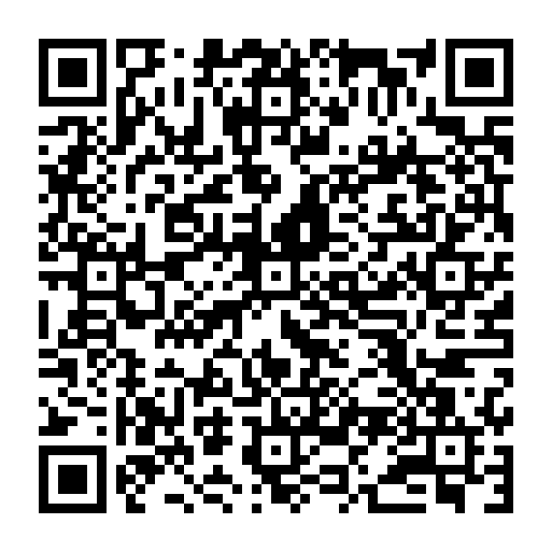
Links to sources on judicial guidance:
https://fastdatascience.com/legal-ai/ireland-expert-witness-conference/

